Slide 1
Displaying the Energy Rating Label
may 2024
Information for retailers, suppliers & appliance representatives.
images used in this presentation are taken from site monitoring activities.

Slide 2
The Energy Rating Label (ERL)
ERLs must be visible when suppling regulated appliances in Australia and New Zealand
ERLs help consumers make informed choices about the appliances they buy. It provides the energy efficiency of the appliance, including the star rating and estimated annual energy consumption.
A model, or family of models, is granted an ERL when it is registered. This assumes it meets the related Greenhouse and Energy Minimum Standards Determination.

Slide 3
When are ERLs required?
ERLs are required to be displayed when supplying, or offering to supply, the following appliances in Australian retail stores:
Single-phase, non-ducted, and unitary or single-split air conditioners up to 30 kW
Clothes dryers
Clothes washers
Computer monitors
Dishwashers
Household refrigerators and freezers
Televisions
Swimming pool and spa pool pumps
ERLs are not required in print or online advertising, but you can use the Energy Rating Icon to help customers make an informed purchase decision.

Slide 4
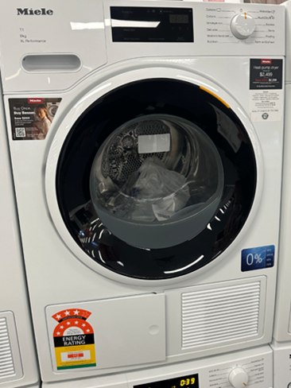
Displaying the ERL on a Clothes Dryer
If out of the box, an ERL must be adhered to the upper front of the dryer facing the consumer or any display front. Other options:
If in a box, an ERL needs to be on the front of the box facing the consumer.
Sometimes the appliance doesn’t have space on the upper front like in the image shown. In this case you can place the ERL on the lower half.
The ERL must face the consumer and cannot be obscured with another appliance or any promotional material.
https://www.energyrating.gov.au/industry-information/products/clothes-dryers

Slide 5
Displaying the ERL on a Clothes Washer
If out of the box, an ERL must be adhered to the upper front of the washer facing the consumer or any display front. Other options:
If in a box, an ERL needs to be on the front of the box facing the consumer.
Sometimes the appliance doesn’t have space on the upper front. In this case you can place the ERL on the lower half.
The ERL must face the consumer and cannot be obscured with another appliance or any promotional material.
https://www.energyrating.gov.au/industry-information/products/clothes-washers

Slide 6
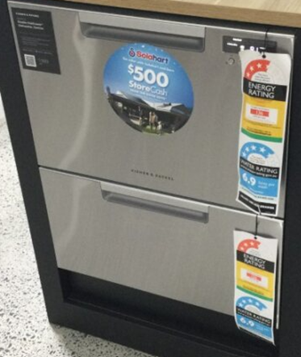
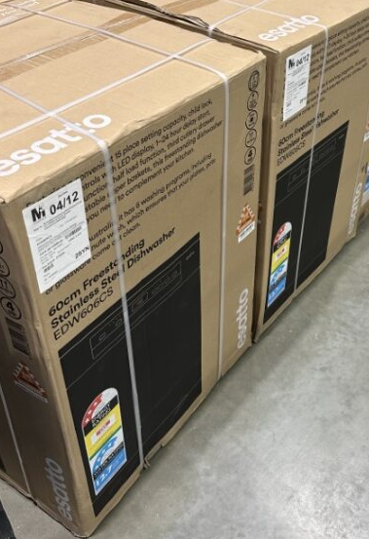
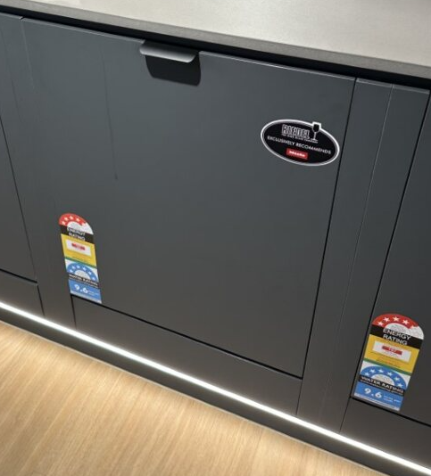
Displaying the ERL on a Dishwasher
When on the showroom floor, the ERL must be placed on the front of the dishwasher or any display front or box facing the consumer. If outside the box, one ERL must be displayed for each draw of a dishwasher.
The ERL must not be obscured.
https://www.energyrating.gov.au/industry-information/products/dishwashers

Slide 7
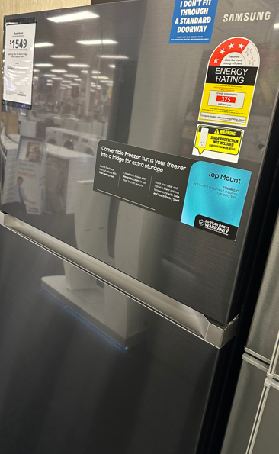
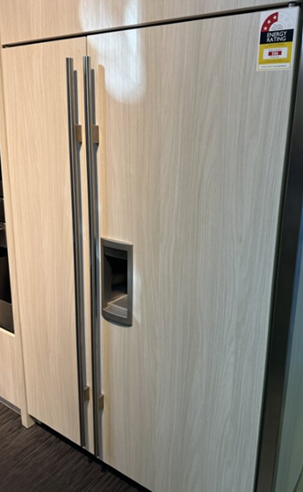
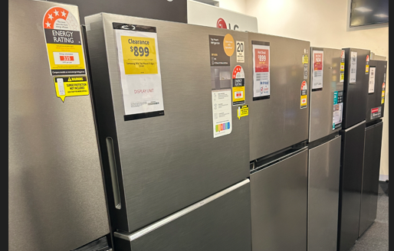
Displaying the ERL on a Refrigerator
If the appliance or its packaging is on display in a retail store, you must ensure that an ERL is clearly visible facing the consumer at the top of any display panel on the refrigerator.
The ERL must be adhered to, attached to, printed on or part of the appliance or its packaging (whichever is displayed).
https://www.energyrating.gov.au/industry-information/products/household-refrigerators-and-freezers

Slide 8
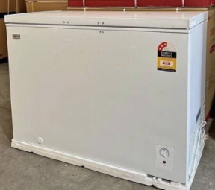
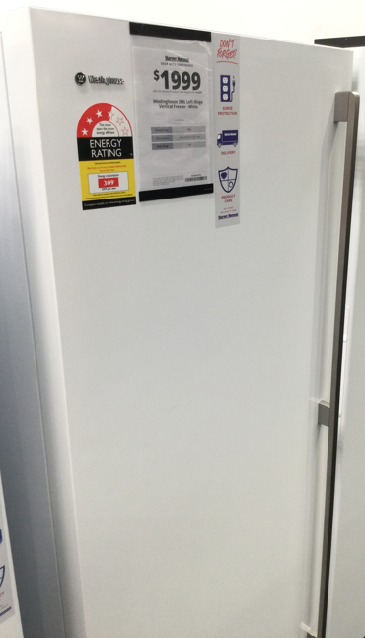
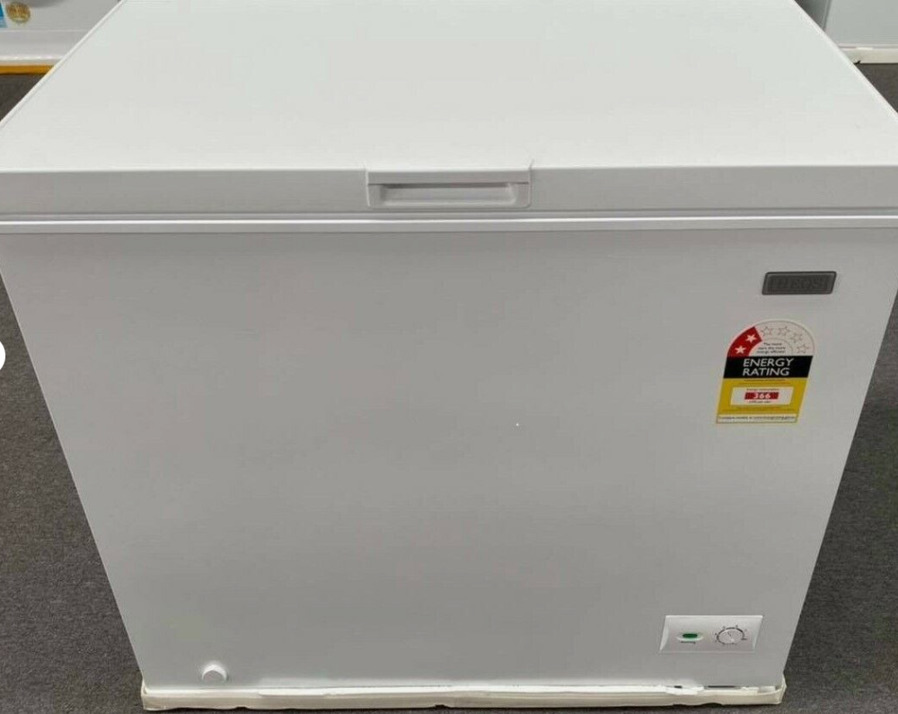
Displaying the ERL on a Freezer
If the appliance or its packaging is on display in a retail store, you must ensure that an ERL is clearly visible and is adhered to, attached to, printed on or part of the appliance or its packaging (whichever is displayed).
https://www.energyrating.gov.au/industry-information/products/household-refrigerators-and-freezers

Slide 9
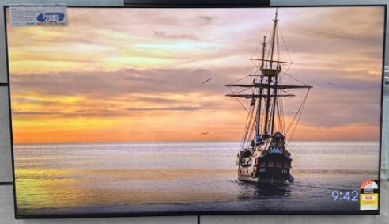
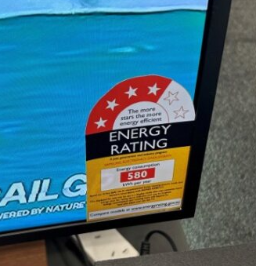
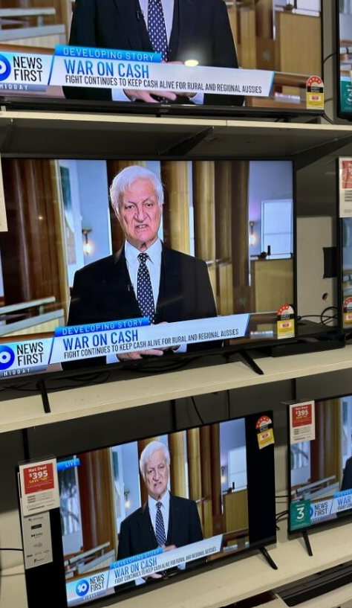
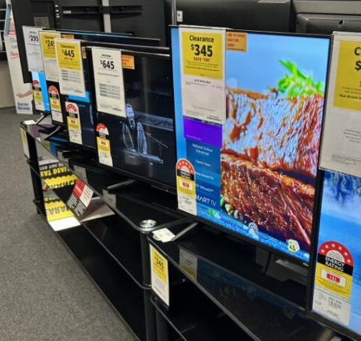
Displaying the ERL on a Television
The ERL must be attached in a way that discourages removal of it in store.
Attach it on the top of the television or directly to the screen or mask.
When overlapping TV’s, make sure the labels are not hidden behind the TV in front of it.
https://www.energyrating.gov.au/industry-information/products/televisions
Notes:
TIPS for using this slide
Use this slide when you have a block of information that needs imagery. Have the image on the left or right. Mix it up throughout your presentation.
Use this slide for two blocks of information relating to the same topic
Think about whether you want to show all the information straight away or hide some of it before you talk about it.

Slide 10
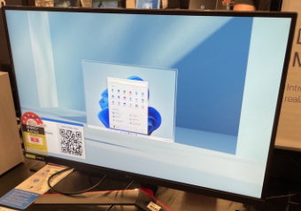
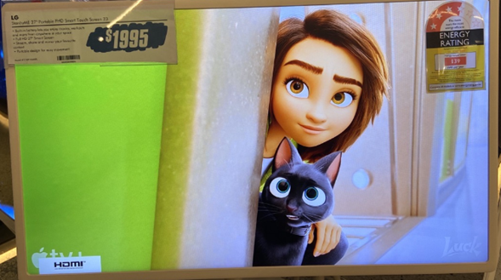
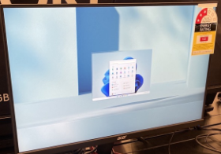
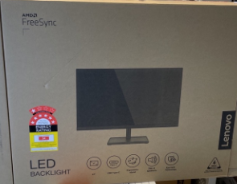
Displaying the ERL on a Computer Monitor
The ERL must be attached in a way that discourages removal of it in store.
Attach it on the top of the monitor or directly to the screen or mask.
If in a box with a colour label on it, face the ERL to the consumer.
When overlapping monitors, make sure the labels are not hidden behind the computer monitor in front of it.
https://www.energyrating.gov.au/industry-information/products/computer-monitors

Slide 11
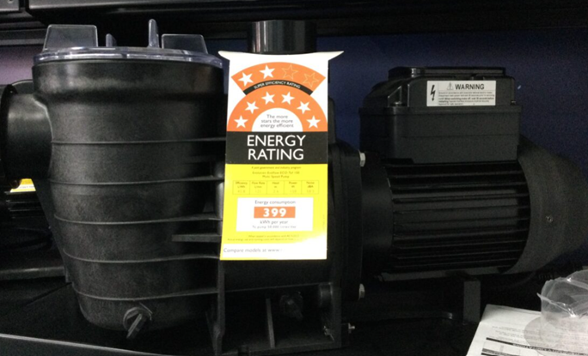
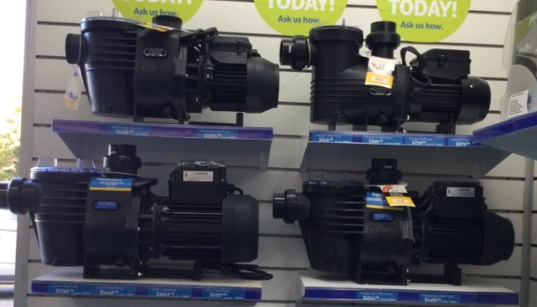
Displaying the ERL on a Swimming Pool Pump
Have at least one ERL clearly visible when the pump is on display.
If out of the box, the ERL must be adhered to the unit or printed on a double-sided swing tag or non-rotating single-sided swing tag.
If on the showroom floor and boxed, adhere the ERL in a place where consumers can see it.
https://www.energyrating.gov.au/industry-information/products/pool-pumps

Slide 12
The Zoned Energy Rating Label (ZERL)
The ZERL was introduced for air conditioners under <65kW in April 2020.
Registered models for sale include
Air conditioners registered to the old determination up to 31 March 2020 must display the ERL. When the model registration expires on or before 31 March 2025, the model must be registered to the new Determination and meet the new requirements.
Air conditioners registered to the new determination from 1 April 2019 must display a ZERL.

Slide 13
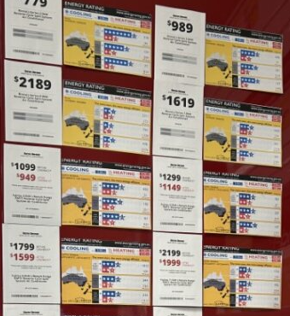
Displaying a label on an Air Conditioner (AC)
If on display in a retail store, you must make sure that the correct label is visible.
If in a box, the correct label must be on the outside of the box.
If selling multiple types of ACs, then you must have a label for each model.
Examples left showing each price tag and ZERL for every variation.
https://www.energyrating.gov.au/industry-information/products/air-conditioners-65kw

Slide 14
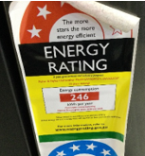
Tips to display the ERL correctly
Check during your weekly floor walk:
Display labels in their full glory
Remove and replace damaged labels
Are the models registered?
Is the right label attached?
Is the label missing?
Can the label be seen by the customer?
Did a new display model go on the floor that needs a label?
Ensure labels are front of mind for consumers to view.
Ensure labels are on the front of the appliance.

Slide 15
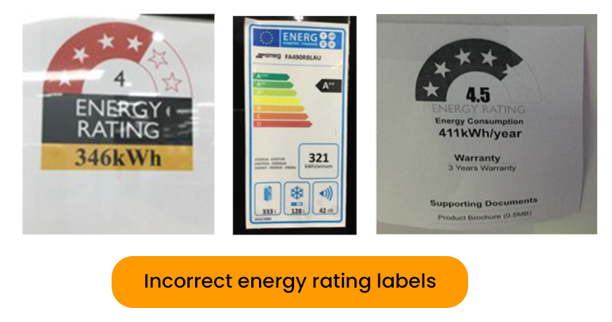
What if an appliance doesn’t have an ERL?
If the appliance is in or out of the box
Ask the supplier or manufacturer to send you a PDF copy of the label, print it in colour at the right size, and attach it to the appliance.
When you receive the original from the supplier, attach it to the appliance and remove the printed copy.
If the supplier or manufacturer is not helpful or you have questions, contact us.

Slide 16
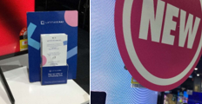
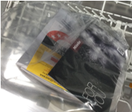
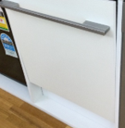
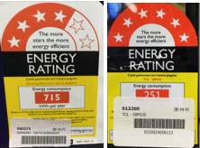
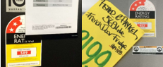
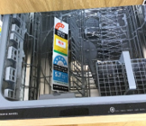
What you shouldn’t do
Don’t obscure the label
Don’t place the label inside the appliance
Don’t display without a label
Don’t cover with store bar codes (common issue during stock take)

Slide 17
Energy Rating Icons (ERIs) and Zoned Energy Rating Icons (ZERIs)
Icons are different to Energy Rating Labels and Zoned Energy Rating Labels.
Icons can only be used for online retail sales and print advertising.
Do not use them to replace ERLs for showroom appliances

Slide 18
More information on Displaying an Energy Rating Label Energy Rating website – www.energyrating.gov.au GEMS appliance or equipment information - https://www.energyrating.gov.au/industry-information/products Labelling - https://www.energyrating.gov.au/industry-information/understand-requirements/labelling Compliance - https://www.energyrating.gov.au/industry-information/compliance Contact GEMS Compliance team: compliance@gems.gov.au

